Slide 1
Group 20 Level 4-5
imdcgd111 Group Project
imdcgd214 Managing Games Production
Ross Warren (S176778)
Max Carter (S175573)
Jake Seaman (S183883)
Jack Fuller (S176802)

Slide 2
Brief
MC
Constraints:
2D Environment
Physics based mechanic
Adversarial
Played on a single device
Symmetric
Simple rules

Slide 3
Our Game - Sunny Slide Up
RW
Tagline – Slip and slide delicious eggs into the perfect cooking position. Hard boiled, scrambled and many more egg-stravagant meals come sliding down the pan in Sunny Side Up
Platforms – iOS / Android

Slide 4
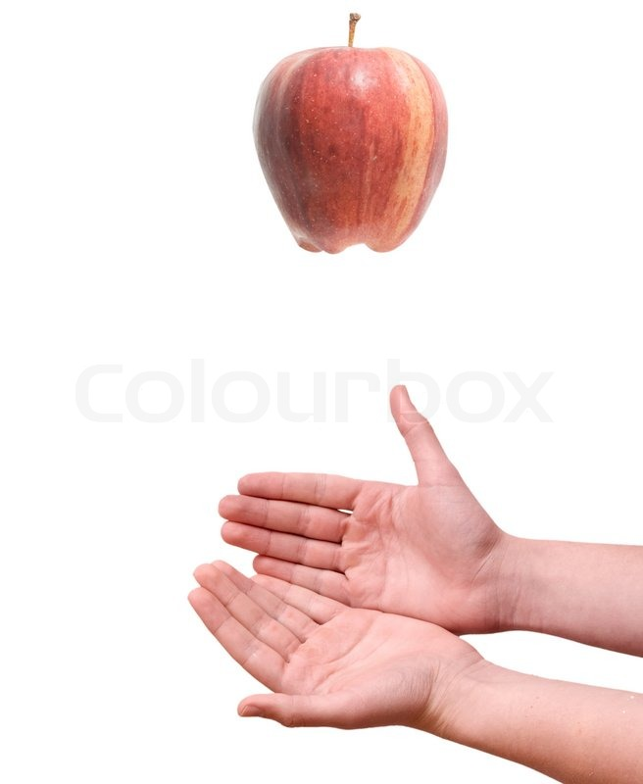
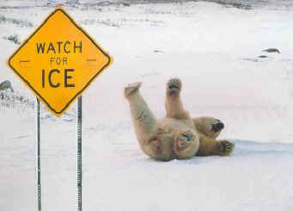


Concepts and Game Ideas
JS
Buoyancy
Friction
Gravity
Light

Slide 5
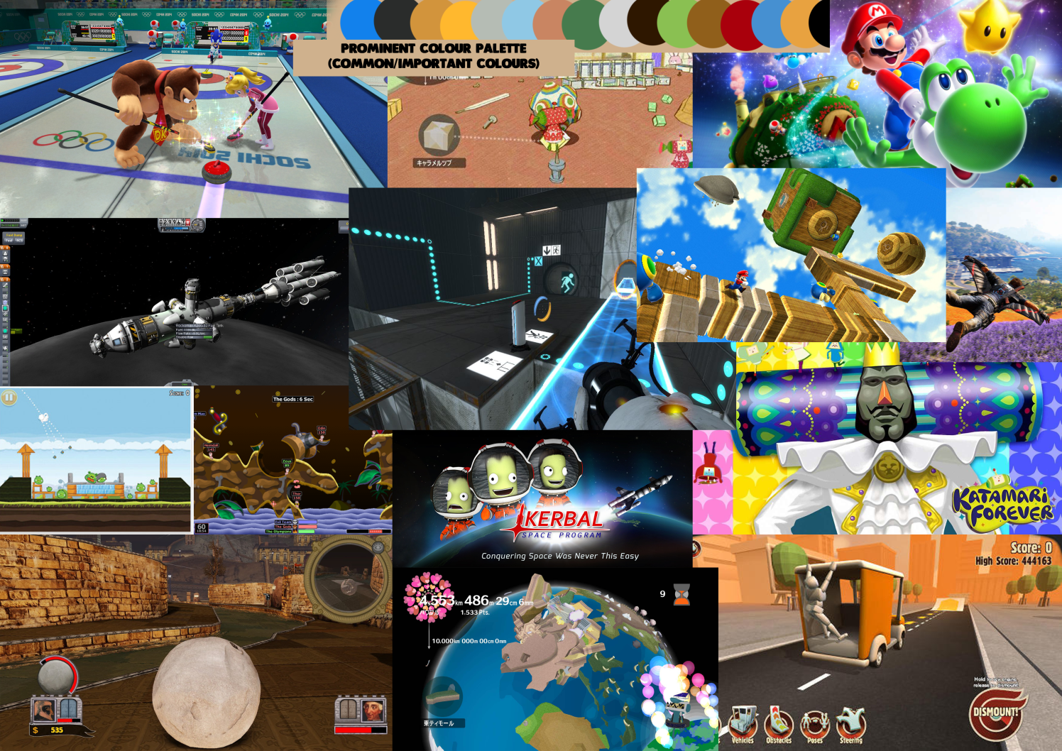
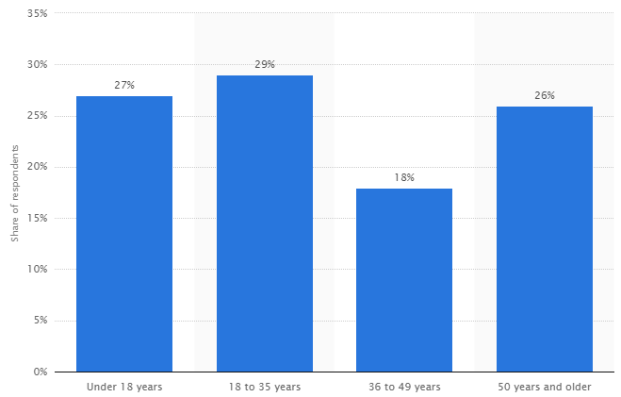
Research + Demographic
JF
Established demographic of mostly males aged 12 – 35
Colourful
Vibrant
Minimalist or smooth
https://www.statista.com/statistics/189582/age-of-us-video-game-players-since-2010/

Slide 6
Old Mechanic
JS
Friction
Twitch

Slide 7
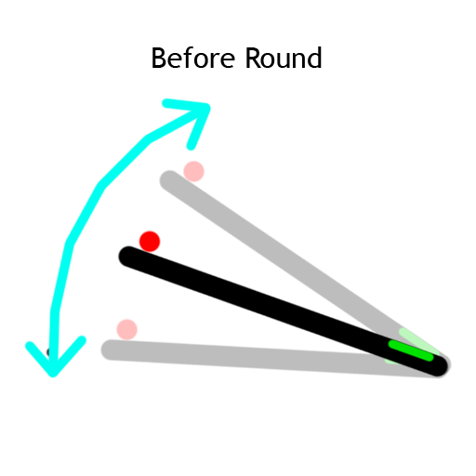
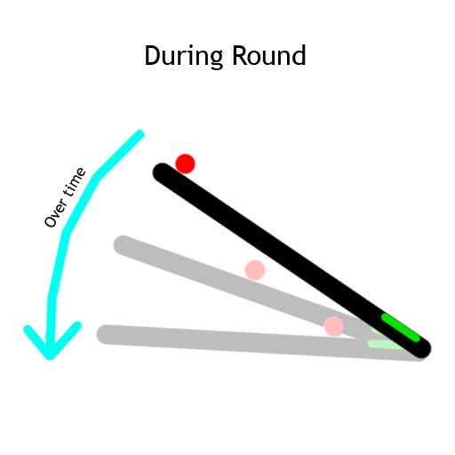
New Mechanic - Angling
MC
Friction
Unpredictability
Twitch mechanic removed
Notes:
We are currently working on playtesting this to see if the players enjoy it and to see if it fits our game

Slide 8
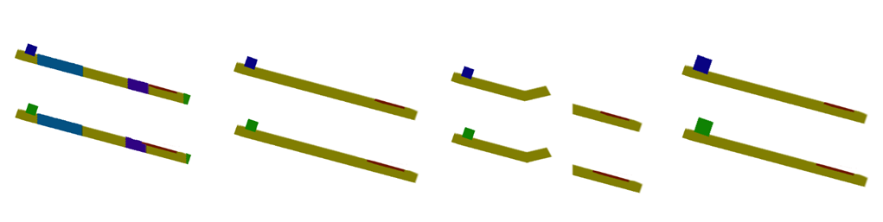
Iterations
JS
The increasing and decreasing of friction.
The movement of the end goal.
Player character also effecting the friction.
Instant stop or slow stop
Different level frictions.
Moving end goal.
Jumps.
Player characters differing friction

Slide 9
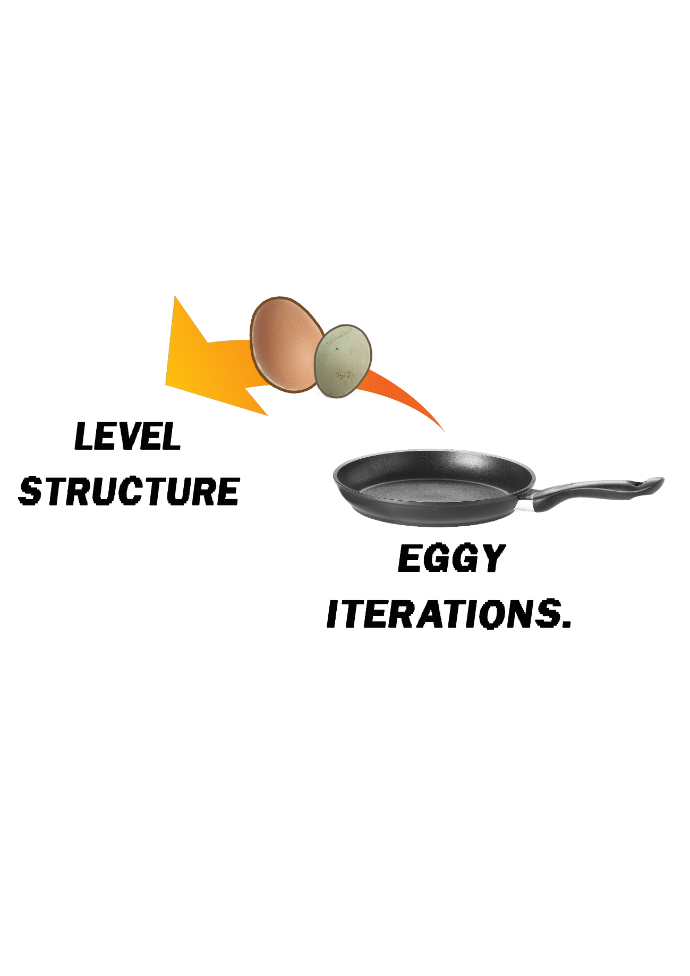
Level Structure
RW
5 Level Structure.
Calls for prefabs of iterations.
Ramps up difficulty.

Slide 10
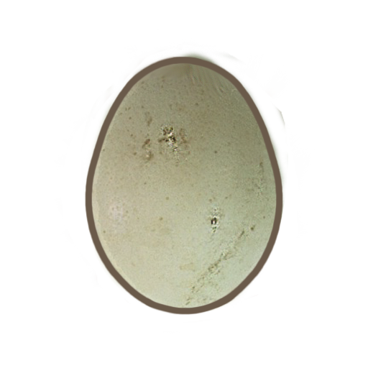
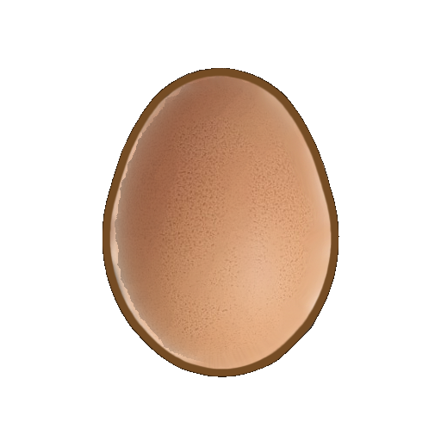
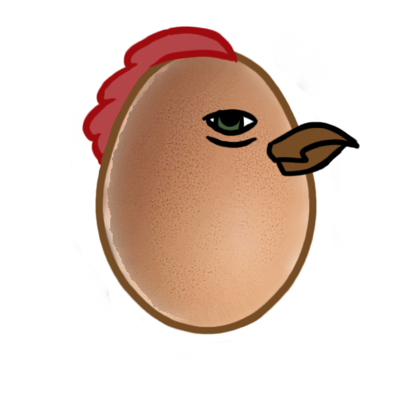

Art assets
RW

Slide 11


Replay Value
JF
Trophies
High Scores
“Omelettin’ this slide”
“Cracking!”
“Shell shock!”

Slide 12
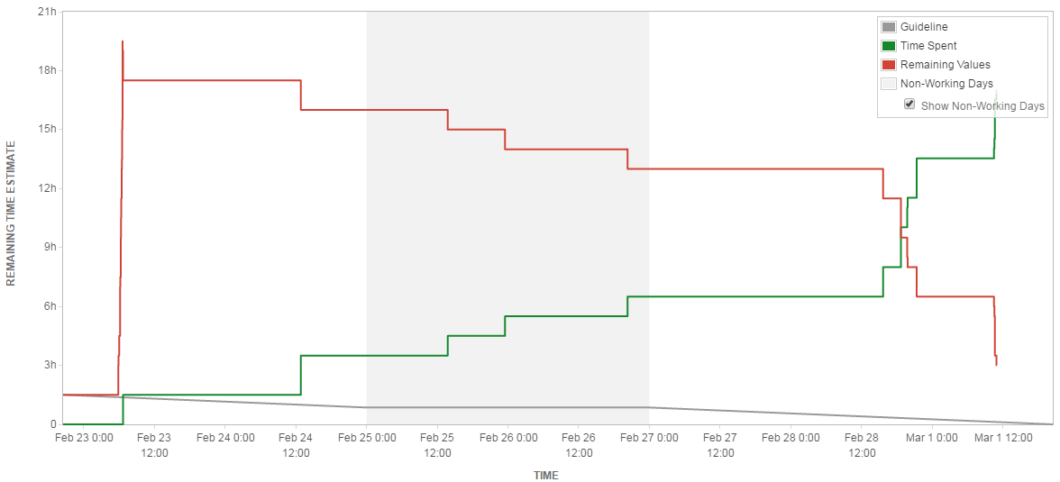
Emails and Jira
MC
Emails this week:
Max – 11 Ross – 8 Jake – 7 Jack - 8

Slide 13
RW
Questions?

